Slide 1


Team 36: Self-Navigating, Obstacle Avoiding Robot
Bi-Weekly Update 5 Teammates:
Arkadi Zhanov
Nathan Sommer
Nikolai Paderin Sponsor: Stavros Kalafatis
Notes:
Michelle

Slide 2
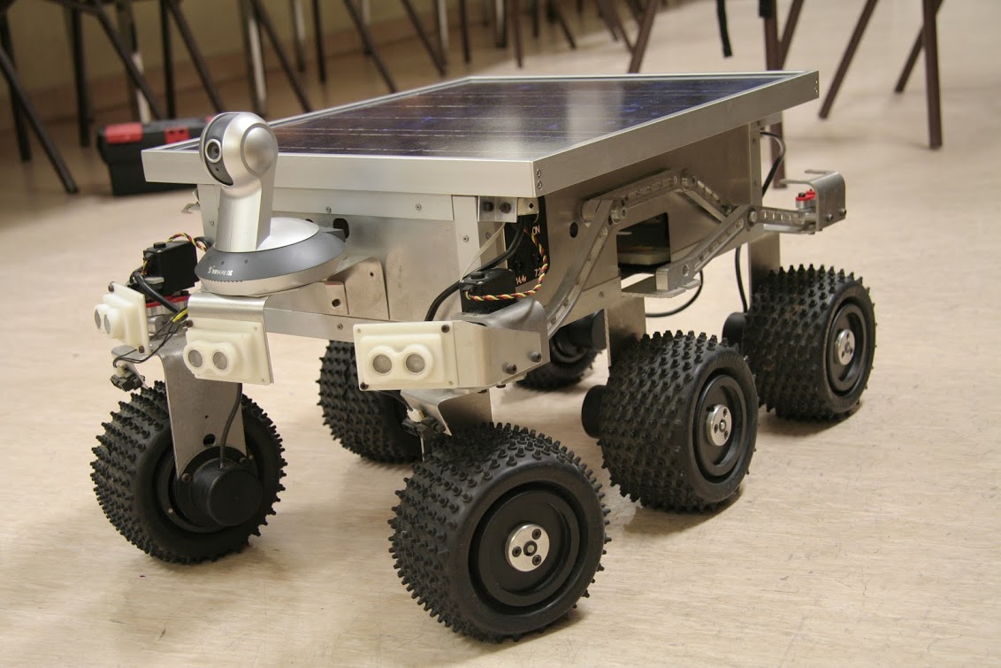
Project Summary
Create a system that takes in a point on a map as the rover’s destination, creates a route for the rover, and gets the rover to its destination and back while avoiding obstacles.
The main motivation for this project is for application in military settings such as aid delivery to wounded soldiers in the battlefield or local, residential delivery of food or mail.
Notes:
Kyle

Slide 3
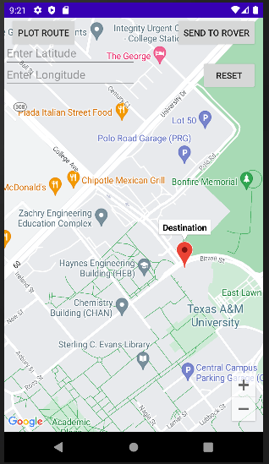
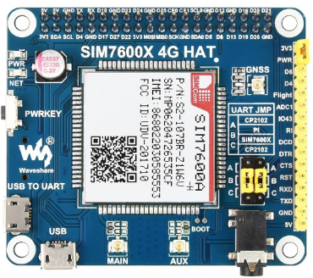
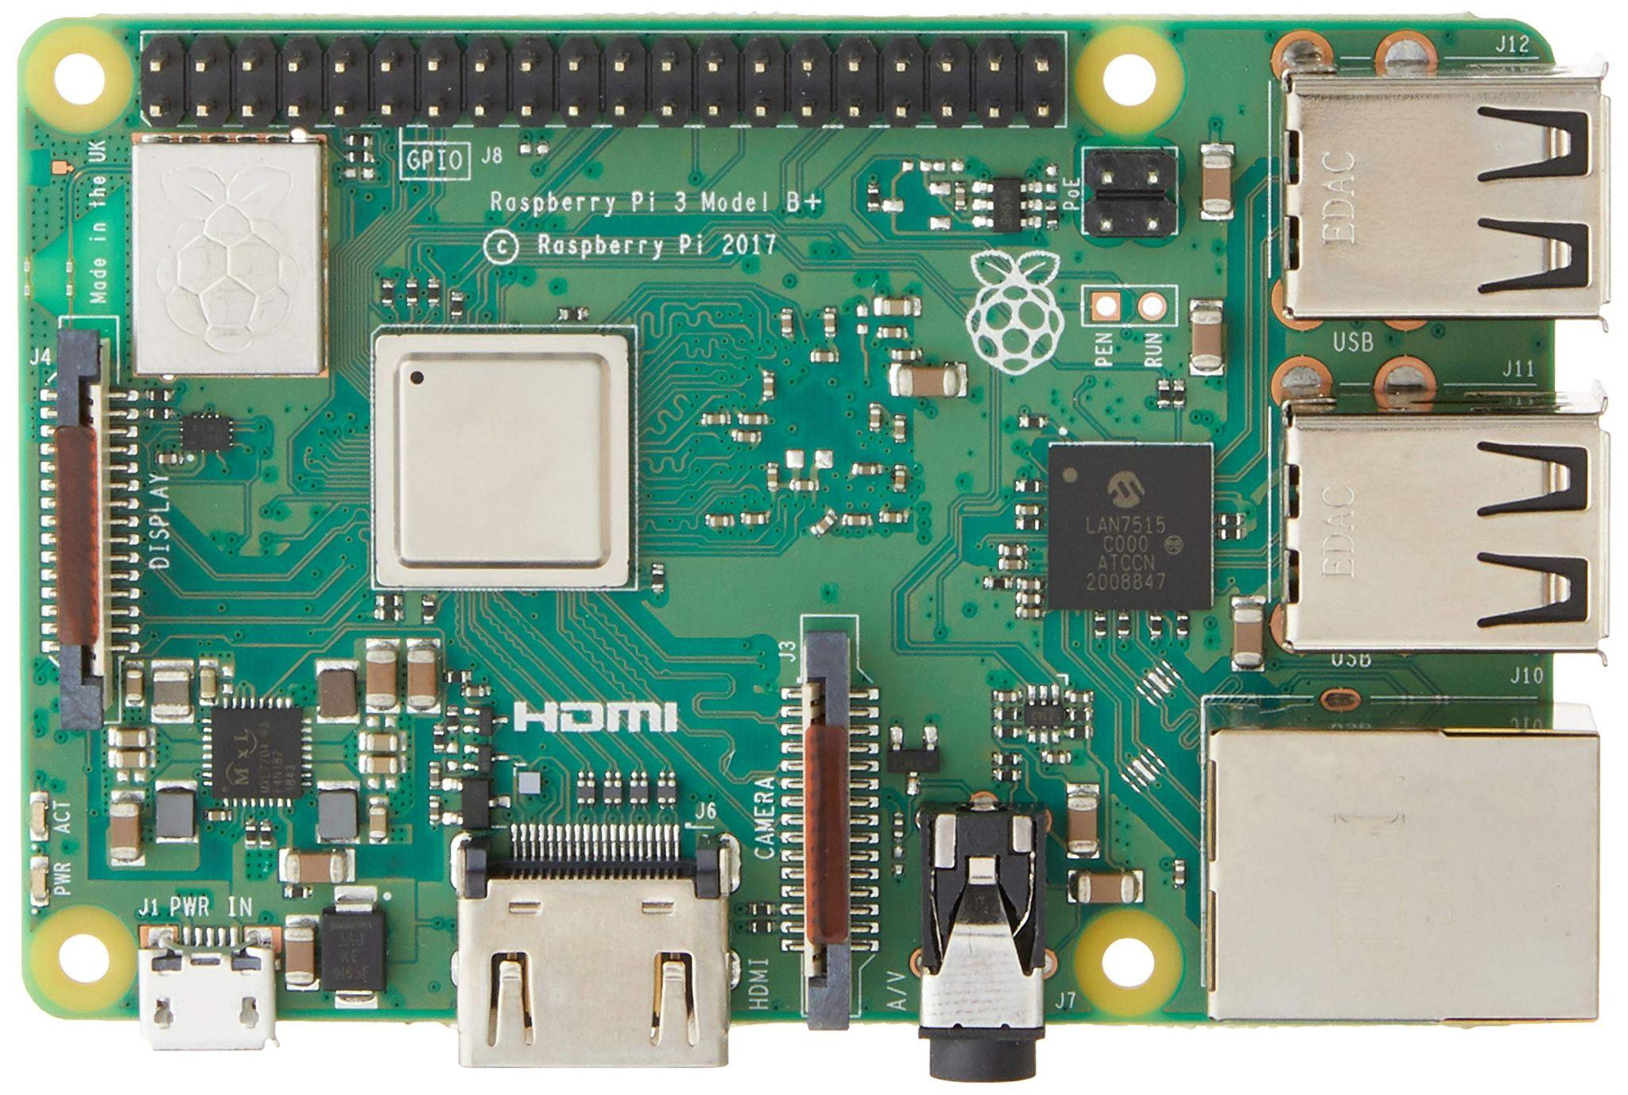
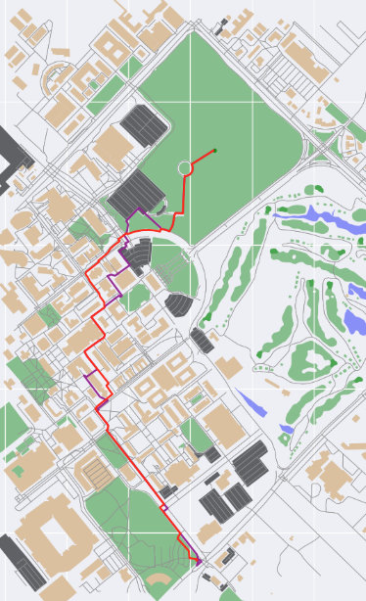
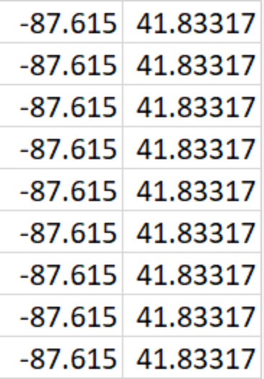
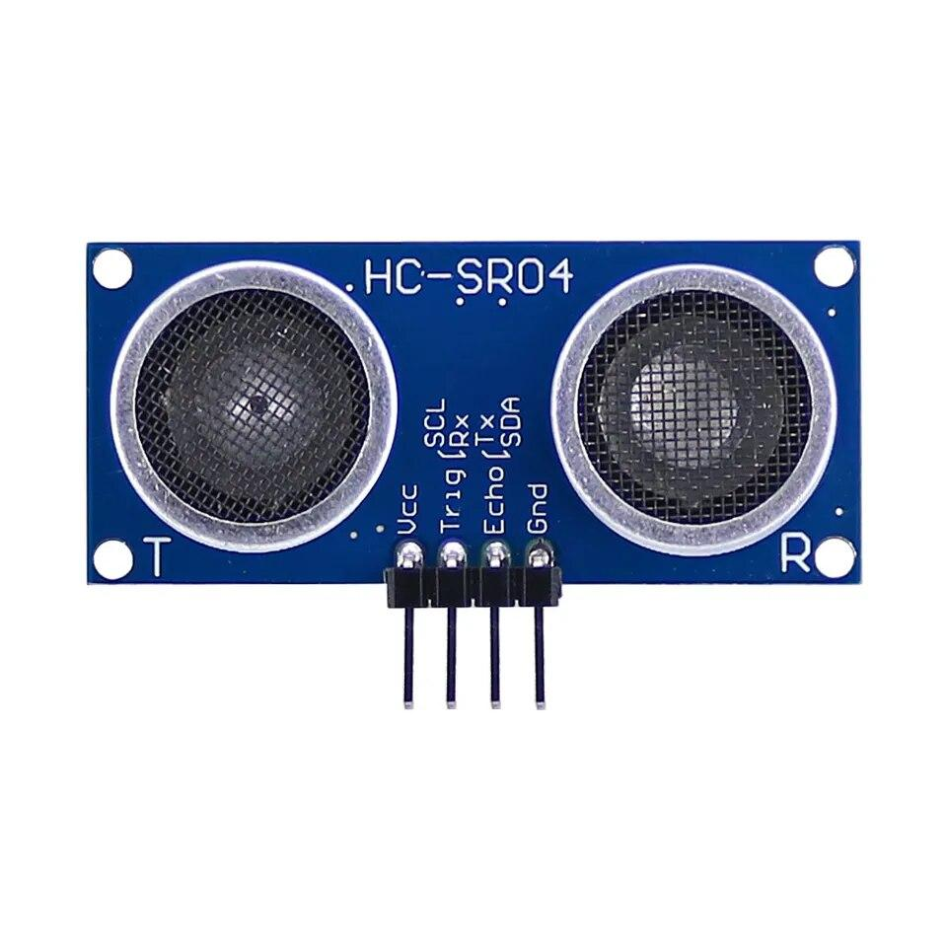
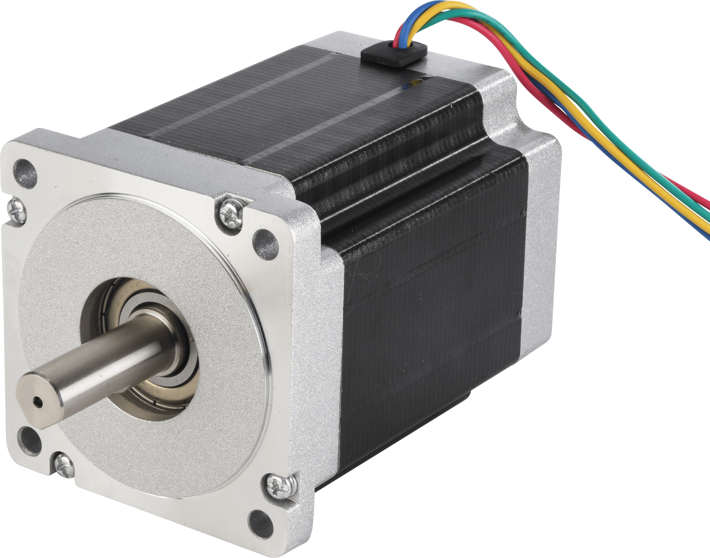
Integrated System Diagram
Route Creation (On Raspi)
App
4G HAT
Raspberry Pi
Receives Route
Receives Location
Sends Data
Sends User Destination
Sends Location and Destination
Override navigation movement control and use obstacle avoidance movement
Obstacle avoidance sensor array detects nearby obstacles
Control motor movement based on current position and next node position
Notes:
Eric

Slide 4
Project Timeline
Subsystem Designs and Testing (completed 9/11) | Integrate Pathfinder and Movement/Controls and test (to complete by 9/20 | Integration with Android App and Raspberry Pi using cellular data (to complete by 10/5) | Final Integration (to complete by 10/15) | Systems Test (to complete by 11/2) | Validation (to complete by 11/26) | Demo and Report (to complete by 12/5)
Subsystem Designs and Testing (completed 9/11) | Integrate Pathfinder and Movement/Controls and test (to complete by 9/20 | Integration with Android App and Raspberry Pi using cellular data (to complete by 10/5) | Final Integration (to complete by 10/15) | Systems Test (to complete by 11/2) | Validation (to complete by 11/26) | Demo and Report (to complete by 12/5)
Notes:
Eric

Slide 5
Nathan Sommer
Accomplishments since last update 16 hrs of effort | Ongoing progress/problems and plans until the next presentation
Integration (App - Pi) Fully integrated the app with the raspberry pi Validated that the app is getting and receiving the correct information, as well as updating UI properly Integration (Pathfinder - Pi) Fixed library issue by switching from pi3 to pi4 | Tested whole system to make sure it’s working as planned Error Handling UI Updates

Slide 6
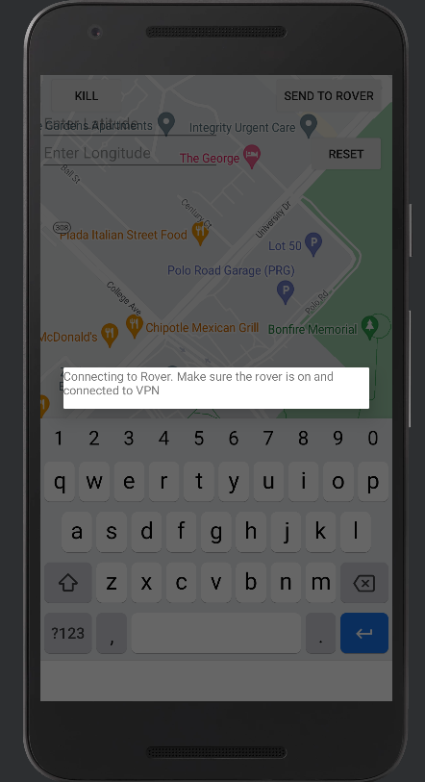
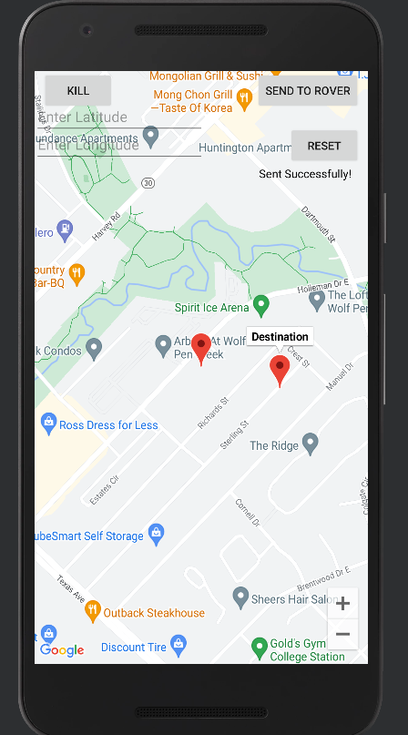
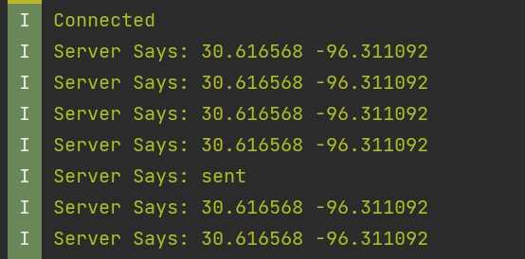
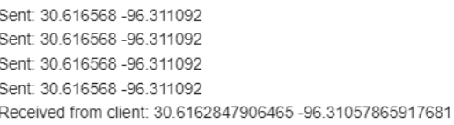
Nathan Sommer

Slide 7
Pathfinding and Navigation
Arkadi Zhanov
Accomplishments since last update 16 hrs of effort | Ongoing progress/problems and plans until the next presentation
Integration/Validation (Pathfinder-Pi) Pathfinder subsystem is complete, verified, and is completely integrated with other subsystems Integration (Obstacle Avoidance-Pi) 3D Printed stable housing for ultrasonic sensors Integration/Validation (System Wide) Developed main loop to combine all systems and control logic flow of rover operations Ongoing obstacle avoidance code validation testing on system wide level | Pick the better obstacle avoidance procedure by system wide testing Finalize testing and validation of obstacle avoidance system wide Test and validate main loop with all system Help with other subsystems

Slide 8
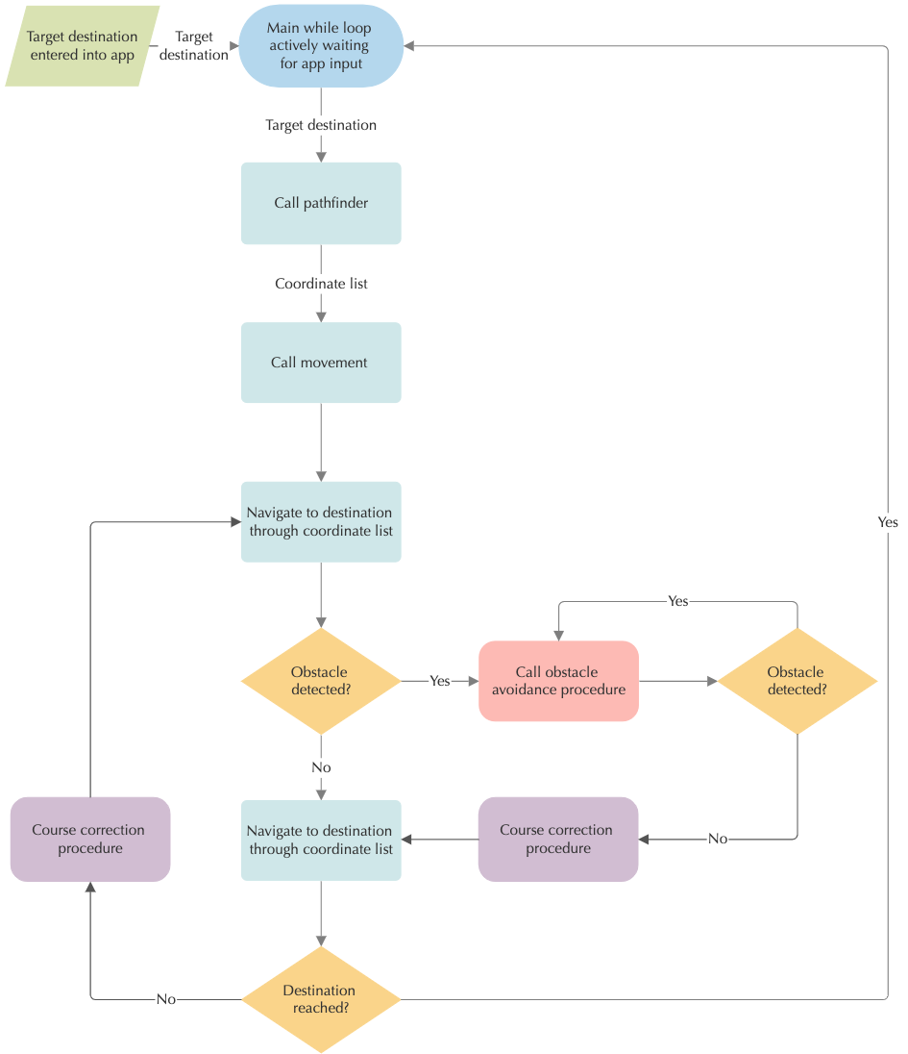
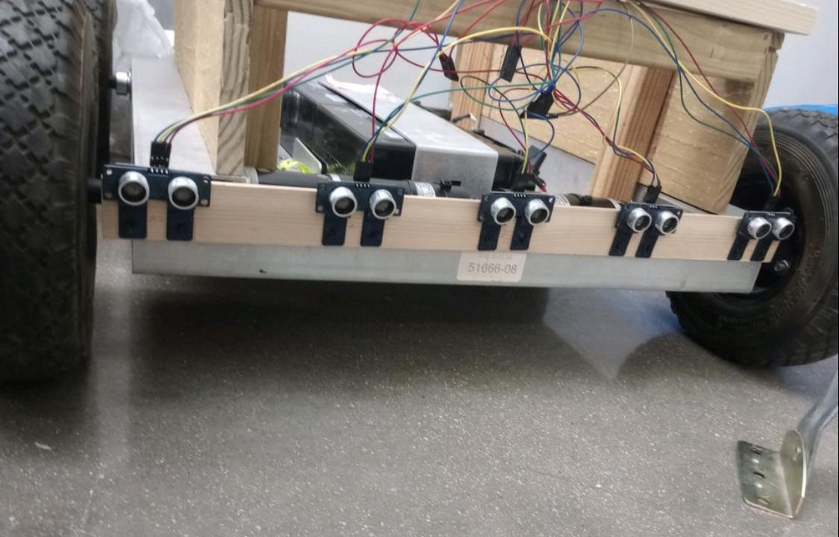
Pathfinding and Navigation
Arkadi Zhanov
Fig 2. Integrated obstacle avoidance sensor array on rover
Fig 1. System wide control flow and logic diagram of main code

Slide 9
Navigation/Movement/Control
Nikolai Paderin
Accomplishments since last update 20 hrs of effort | Ongoing progress/problems and plans until the next presentation
-Rover integration with pathfinding and application complete. -Tested Rover movement outside -GPS information being pulled properly -Integrated pathfinder with GPS module -Validated APP to Pi connection + transfers -Validated pathfinding to instruction algorithm | -Recalibrate movement code for ground outside lab -Re-calibrate GPS(offset) -Allow app full control over rover + pi actions

Slide 10
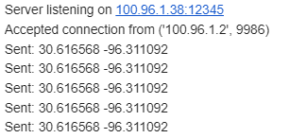
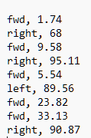
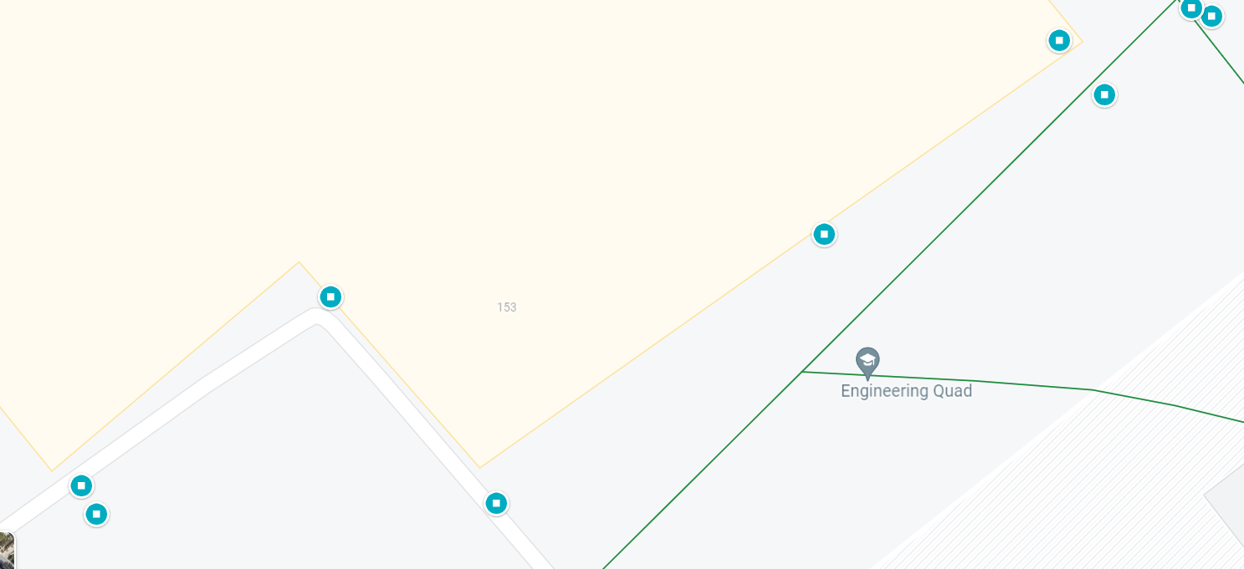
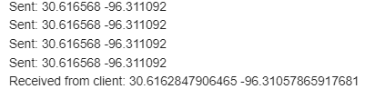
Navigation/Movement/Control
Nikolai Paderin

Slide 11
Execution Plan
Miletone/Timeline | Aug 31 | September 7 | September 14 | September 21 | September 28 | October 5 | October 12 | October 19 | October 26 | November 2 | November 9 | November 16 | November 23 | November 30
 |  |  |  |  |  |  |  |  |  |  |  |  |  | Have not started
Finish 403 Objectives + cleanup Nikolai |  |  |  |  |  |  |  |  |  |  |  |  |  | Behind
Finish 403 Objectives Nathan |  |  |  |  |  |  |  |  |  |  |  |  |  | In Progress
Finish 403 Objectives Arkadi |  |  |  |  |  |  |  |  |  |  |  |  |  | Work finished
Order any additional parts necessary
Integrate pathfinding code + Rover movement
Install 4G hat
Enable Connectivity between App + Raspberry pi
Full Integration
System Test
System Validation
Testing and final checks + troubleshooting
Notes:
Michelle

Slide 12
SYSTEM Validation Plan
REQUIREMENT | SUCCESS CRITERIA | METHODOLOGY | STATUS | ENGINEER RESPONSIBLE
FSR Pg10 | Have all sensors + movement code working and precise | Test sensors, and rover movement by measuring and calibrating | Complete | Nikolai
FSR Pg10 | Add the Connection Page + Help Arkadi with navigation subsystem | Test to see if subsystem is fully operational and working as intended | Complete | Nathan
FSR Pg10 | Have the navigation/pathfinder code working as intended. | Using two points create a series of nodes that connect them using the code | Complete | Arkadi
FSR Pg10 | Have the Raspberry pi communicate with pathfinding code and integrated | Using the Pi, send info to the pathfinding subsystem to create a path | Complete | Nikolai + Arkadi
FSR Pg10 | Have the Raspberry pi integrated with a 4G hat such that it has internet access wherever it is. | Using the Pi and the 4G hat, give the Pi internet access through a cellular network | Complete | Nikolai
FSR Pg10 | Have the Raspberry pi send and receive information from the App | Test sending information with Raspi and App using sockets | Complete | Nathan + Nikolai
FSR Pg10 | Have the raspberry pi receive accurate GPS information from its antenna | Use google maps to determine whether the GPS coordinates are accurate from its location | In Progress | Nikolai
FSR Pg10 | Have the rover move accurately according to the instructions | Measure the distances and angles the rover travels to ensure they align with instructions | In Progress | Nikolai
FSR Pg10 | Able to effectively control the rover using the app | Able to send commands over 4G network to the pi, and have it follow the given instructions | In Progress | Nikolai + Nathan
FSR Pg10 | Rover is successfully able to move around obstacles | Sending the rover on a give path, determining if it detects objects in path, correctly moves around them | In Progress | Nikolai + Arkadi
FSR Pg10 | System is working as intended | See if system works in actual environment | In Progress | Nathan + Nikolai + Arkadi
FSR Pg10 | Validate the whole system, and make sure it works | Stress-Check System, and see if everything works as intended | Not Complete | Nathan + Nikolai + Arkadi
FSR Pg10 | All subsystems are successfully talking to each other, and can operate autonomously | Use app to get user destination, and see if rover goes to destination using all subsystems | Not Complete | Nathan + Nikolai + Arkadi
Notes:
Michelle

Slide 13
THANK YOU FOR YOUR TIME
ANY QUESTIONS?

